Slide 1
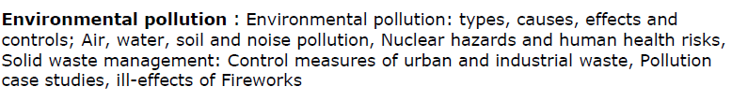
Pollution and Solid Waste

Slide 2
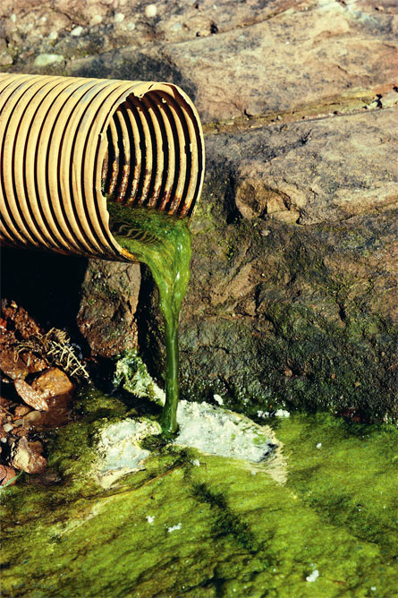
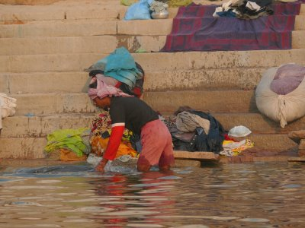
Water Pollution
The addition of various organic and inorganic substances that change the
physical and chemical properties of water thereby leading to detrimental effects on living organisms and reducing water usability is termed as water pollution.

Slide 3
Causes of Water Pollution
Natural Causes-
Soil erosion due to rain, floods, high speed wind.
Deposition of dead and decaying remains of plants and animals.
Man-made Causes-
Sewage and other wastes- Includes papers, cloth, soap, detergents, waste.
Industrial waste- effluents such as oil, grease, plastic, metals, acids and other toxic chemicals.
Agricultural waste – fertilizers, pesticides.
Human activities – bathing, clothing, washing.
Customs and traditions- disposal of dead bodies, immersion of idols of gods.

Slide 4
Sources of water pollutants
Point sources-Pollutants enter the water at a single point-- sewage treatment plant and factories. These can be regulated through law.
Non point source- pollutants enter the water over large areas--Surface run off, mining wastes, municipal wastes, acid rain and soil erosion.

Slide 5
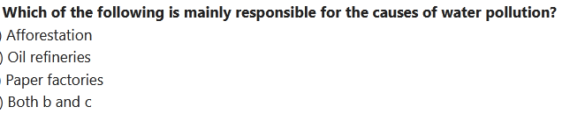

Slide 6
Water Pollutants and its effects
Sediments: Excessive amounts of soil particles carried by flowing water, when there is severe soil erosion. Sediments cloud the water and reduces photosynthesis, destroys feeding ground of fishes, clogs reservoirs and channels.
Oxygen-demanding wastes: Organic waste such as animal manure and plant debris that are decomposed by bacteria, from sewage, animal feedlots, paper mills, and food processing facilities. These bacteria deplete the oxygen and causes death of fish.
Infectious microorganisms: Parasitic worms, viruses and bacteria from infected organisms as well as human and animal wastes. They are responsible for water borne diseases.
Organic compounds: Synthetic chemicals containing carbon from industrial effluents, surface runoff, and cleaning agents. These chemicals causes health problems for humans and harm fishes.

Slide 7
Water Pollutants (contd)
Inorganic nutrients: Substances like nitrogen and phosphorus from animal waste, plant residues, and fertilizer runoff. These nutrients causes eutrophication.
Inorganic chemicals: Acids, salts, and heavy metals like lead and mercury from industrial effluents, surface runoff, and household cleaning agents. They make water unfit for use and harms aquatic life.
Radioactive substances: Wastes from nuclear power plants, nuclear weapons production, mining and refining uranium and other ores. Such substances causes cancer and birth defects.
Thermal pollution: Hot water from industrial processes. Heat lowers oxygen demand and makes aquatic life more vulnerable to diseases, parasites. Thermal shock in aquatic organisms.

Slide 8
Effects of Water Pollution
Effect on human health-
Various diseases of CNS, damage to liver, brain and kidney.
Diseases caused by contaminated drinking water-Leads to various waterborne diseases such as diarrheoa, typhoid, cholera, infectious hepatitis, jaundice, etc., in human beings
Bacteria–
1)Typhoid
2) Cholera—vomiting.
3) Diarrhoea
Viruses-
Infectious hepatitis– Fever, severe headache, loss of appetite, abdominal pain, jaundice, enlarged liver.
Parasitic protozoa-

Slide 9
Effects on animals-
Harmful chemicals and pollutants in water effect survival of aquatic organisms-- Loss of aquatic biodiversity
Effects on plants-
Nitrate and phosphate fertilizer used to increase nitrogen and phosphate content of soil goes in water and increases the growth of certain plants on surface of water body--Eutrophication of water bodies
Polluted water contains high concentration of heavy metals becomes toxic for plants.

Slide 10
Pollution of Groundwater
Excessive extraction of groundwater leads to the natural pollution of groundwater. Examples are fluoride and arsenic contamination.
Groundwater receives pollutants from septic tanks, landfills, hazardous waste dumps, and underground tanks containing petrol, oil, chemicals, etc.

Slide 11
Eutrophication
Enrichment of a standing water body by nutrients, such as phosphorus and nitrogen.
Increased photosynthetic activity.
Excessive algae die, they fall to the bottom and gets decomposed. This process requires dissolved oxygen, some fish species die.

Slide 12
What happens when phosphorus, nitrates, and detergents in water lead to an acceleration in the growth of algae?
a) Extinction b) Eutrophication c) Increase in the number of fishes d) Increase in the number of aquatic plants

Slide 13
Biomagnification
Biomagnification is the increase in concentration of a substance, such as the pesticide, that occurs in a food chain. The pollutant enters the first organism in a food chain. When the second organism in the chain consumes the first one, the pollutant too moves into the second organism.
As we go up the levels of the ecological pyramid, there is energy loss. Hence, at each succeeding level, the predator consumes more of the prey. As a result, the organisms at higher levels have greater concentrations of the pollutant.

Slide 14
Control of Water Pollution
Treatment of domestic and industrial waste in order to reduce toxicity.
Control on excess use of fertilizers and pesticides in agriculture
Human activities such as bathing, washing ; throwing dead bodies; immersion of idols should be stopped.
Non- biodegradable waste material such as plastic should not be disposed in water bodies.
Strict enforcement of rules
Public awareness

Slide 15
Related links
Eutrophication
https://www.youtube.com/watch?v=6LAT1gLMPu4

Slide 16
Soil Pollution
Any change in the physical, chemical, and biological properties of soil due to natural or anthropogenic activities is known as soil pollution.
Major Soil Pollutants and their effects
1) Heavy Metal
2) Chemical waste
3) Pesticides, fertilizers and other agricultural products
4) Lead, Cadmium
5) Radioactve waste

Slide 17
Causes of Soil Pollution
Industrial waste
Mining
Agricultural waste
Domestic waste
Radioactive wastes
Effects of Soil Pollution
Reduces the fertility of the soil
Causes an increase in the number of mosquitoes and flies, which are vectors of several deadly diseases
Reduces the aesthetic value of land
Radioactive elements present in polluted soil enter human body and cause a number of adverse health effects such as cancer, deformities in bones, etc.

Slide 18
Control of Soil Pollution
Treatment of industrial waste before being disposed to reduce soil pollution.
Garbage from urban waste should be segregated into biodegradable and non-biodegradable waste products. Biodegradable waste can be used for production of manures and biogas, non-biodegradable waste can be recycled and reused.
Planting of trees must be encouraged.
Reduction in the amount of radioactive materials released in the soil
Reduction in the use of chemical fertilizers and pesticides
Solid waste can be used for electricity generation.

Slide 19
Video link:
Major soil pollutants and their impacts on human health.
https://www.youtube.com/watch?v=FMdt7w59wHQ
Soil Pollution
https://www.youtube.com/watch?v=00c4goQRLek

Slide 20
9. A moth having a speckled wing, able to blend into its background due to its dark colouration is called
Industrial melanism
Adaptation
Predation
Evolution
10. Carbon dioxide is primarily called a greenhouse gas because
Traps heat
Traps light
Traps warm currents
None of the above
11. Trichoderma harzianum is a ________ that is predominantly used as a fungicide
Virus
Fungus
Bacteria
Protozoa
12. Greenhouse gases are those that absorb and emit infrared radiation. Examples inlude__________
Nitrogen
Ozone
Argon
None of the above

Slide 21
9. A moth having a speckled wing, able to blend into its background due to its dark colouration is called
Industrial melanism
Adaptation
Predation
Evolution
10. Carbon dioxide is primarily called a greenhouse gas because
Traps heat
Traps light
Traps warm currents
None of the above
11. Trichoderma harzianum is a ________ that is predominantly used as a fungicide
Virus
Fungus
Bacteria
Protozoa
12. Greenhouse gases are those that absorb and emit infrared radiation. Examples inlude__________
Nitrogen
Ozone
Argon
None of the above

